Slide 1





MARKETPLACE FOR NORTHWEST
Section 03
Team 03
Dr. Chandra mouli KOTTETI – Client/mentor
Hari Kiran aluri – Team lead/Front-end developer
Sajida mohammad – Backend developer
KIRAN KUMAR GUNDAPUNENI– Backend developer
USHA PATI – Tester/QA

Slide 2
Introduction
Market place for Northwest Missouri
Students can purchase or sell products
CURD Operations can be performed on products
Presented by Sajida

Slide 3

Contents to be Discussed.
Technical Stack
Need of MVC
Flow in MVC
What is Angular
Overview of Angular
TypeScript
Concepts Overview
Spring Architecture
Spring Boot overview
Spring Boot Advantages
Selenium
Components of Selenium
Web Driver
Functional Testing

Slide 4




Technical Stack
Angular
Spring boot
Selenium
MySQL

Slide 5
Why we need MVC?
Single page coding for application
Difficult to Maintain
Issues with Testing

Slide 6
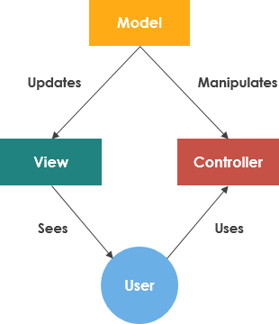
Flow in MVC
Model – Objects with Data
View – User Interface
Controller – Handles the user request
Fig : 1.1 Flow Diagram of MVC

Slide 7

MVC
Loosely coupled
Faster Development
Supports TDD (Test Driven Development)
Multiple Views

Slide 8
What is Angular
Maintained mainly by Angular Team at Google
Uses MVC Framework
Install with npm install –g @angular/cli
Freelancer, the weather channel , NETFLIX , LEGO , iStock ,YouTube, PayPal,
Presented By: Hari Kiran Aluri

Slide 9
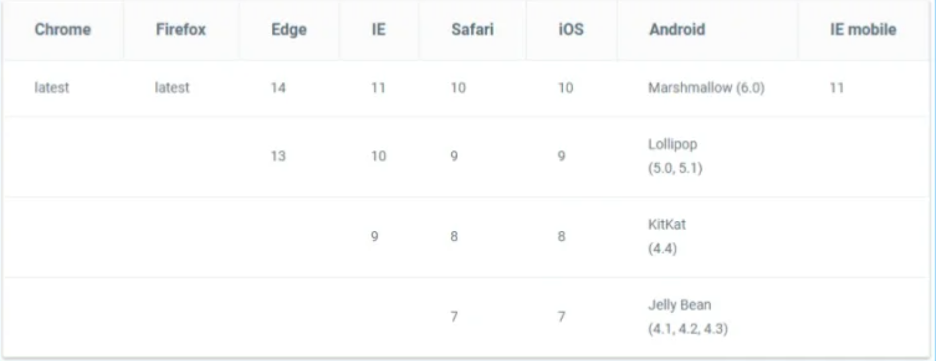
Browsers supports

Slide 10
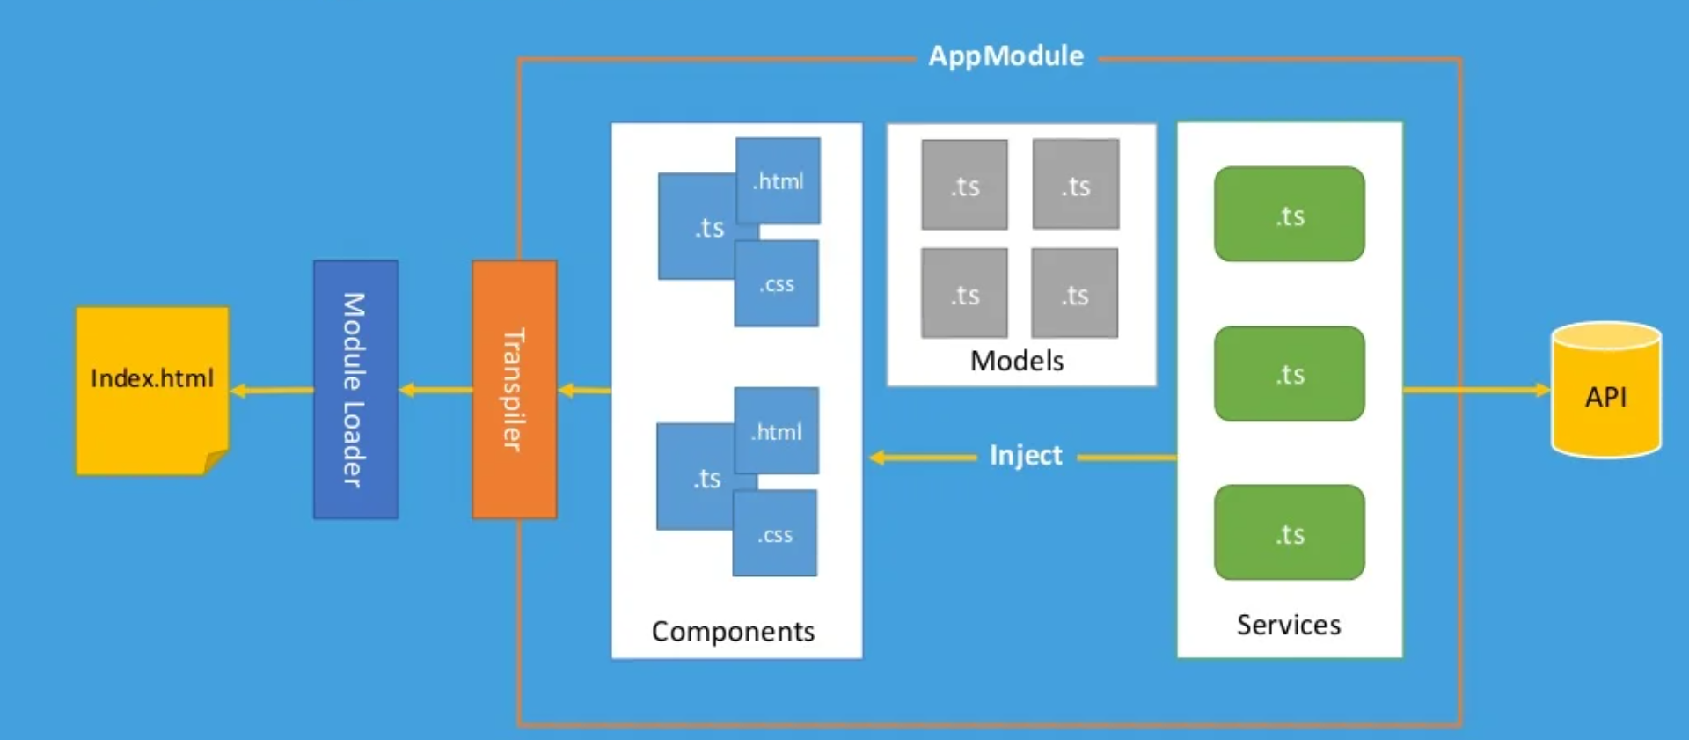
Fig: 2.1 Overview of Angular

Slide 11
Typescript
Typescript is a typed superset of java Script that compile to plain JavaScript
Open Source
Contains interfaces Example: interface person { firstName : string;……
Typed means that you can declare types. Example : fullName:string
Compile with tsc examples.ts
Install with npm install –g typescript@latest

Slide 12
Concepts overview
Components
Dependency injection
Services
Fundamental building blocks of Angular application
Display data on the screen ,Listen for user input and Take action based on the input
Typescript file that contains a class that has @Component attribute
TypeScript file converted to JavaScript during compilation
Can be generated by: ng generate component mycomponent
A technique in software engineering whereby one object supplies the dependencies of another object
Dependency is the object that can be used a service
Injection is ,passing the object that requires it
Angular makes heavy use of dependency injection
Services are used for business logic
It is used to share information among classes
Services are created by dependency injected and used by components or other services
Can be created using a typescript class with @injectable attribute
Can be generated by : ng generate service myservice

Slide 13
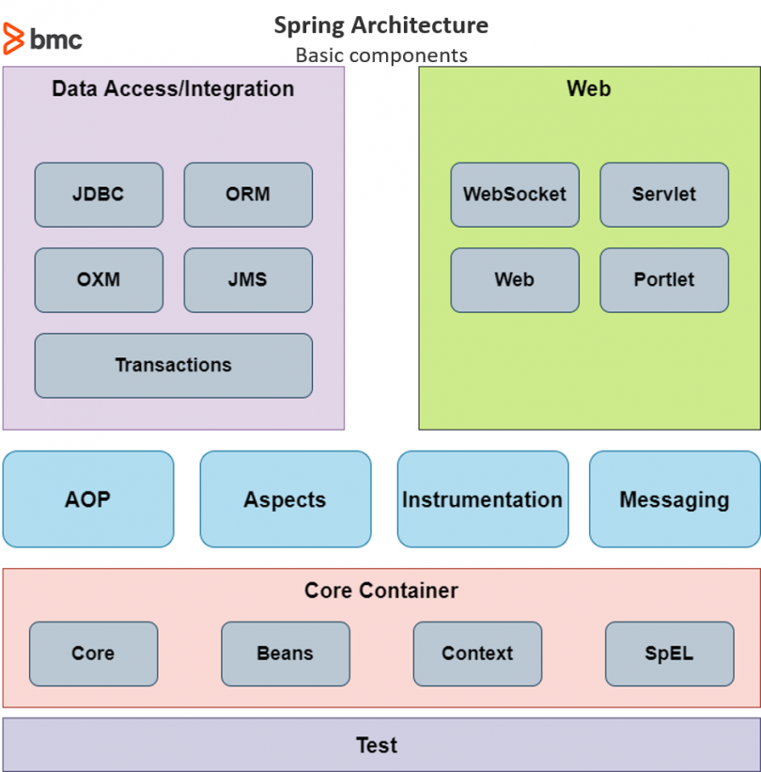
Spring Architecture
AOP – Logging and Caching
Data Layer – JDBC, Hibernate, JPA, JMS
Web layer – Servlet, Web Socket
Fig: 3.1 Spring Architecture
Presented by : Kiran Gundapuneni

Slide 14
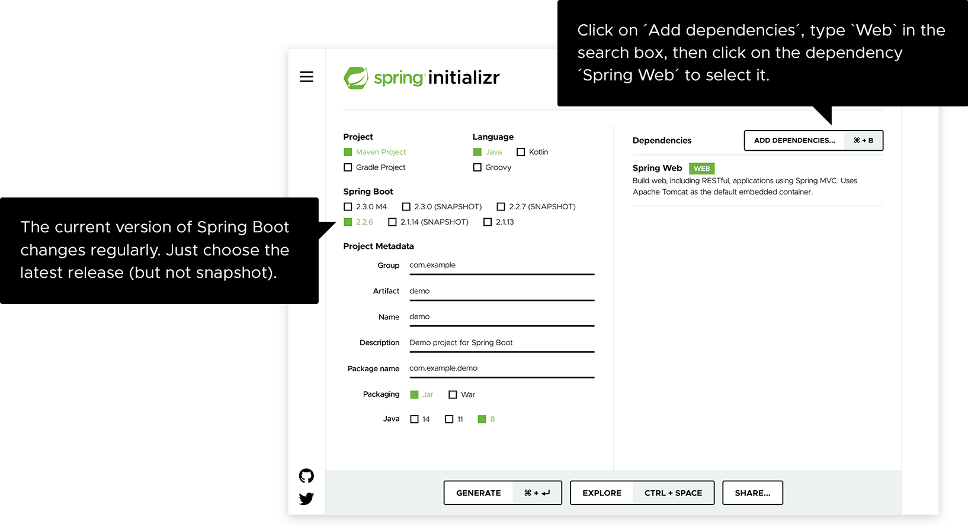
Spring Initializer
Fig: 3.2 Spring Initializer

Slide 15
Spring Boot Overview
Spring Framework is a Java platform that provides comprehensive infrastructure support for developing Java applications.
The Spring Framework is an open-source framework for building enterprise Java applications.
Spring handles the infrastructure so you can focus on your application.

Slide 16
Spring Boot Advantages
Use of POJO
Use of Spring AOP
No need to Reinvent
Ease of testability
Well-designed web framework

Slide 17
SELENIUM
What is selenium?
Selenium is a free (open-source) automated testing framework used to validate web applications across different browsers and platforms.
Requirements:
1)Java software
2) Browser
3)IDE
Presented by : Usha Pati

Slide 18
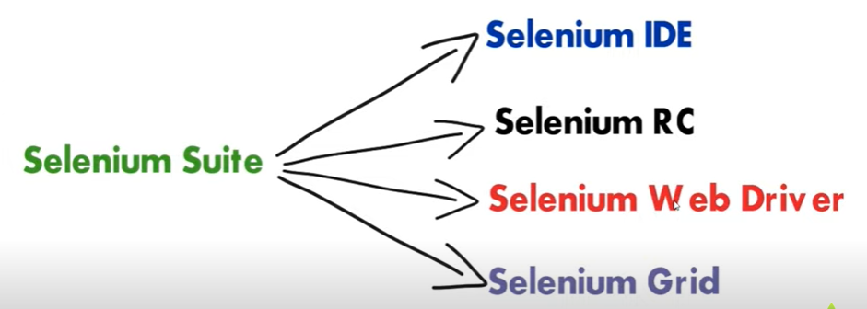
Fig : 4.1 Components of selenium suite
Notes:
Webdriver helps to execute cross browser tests and verify expected result. This contains APi , Library,drivers and frameworks that work together for test execution

Slide 19
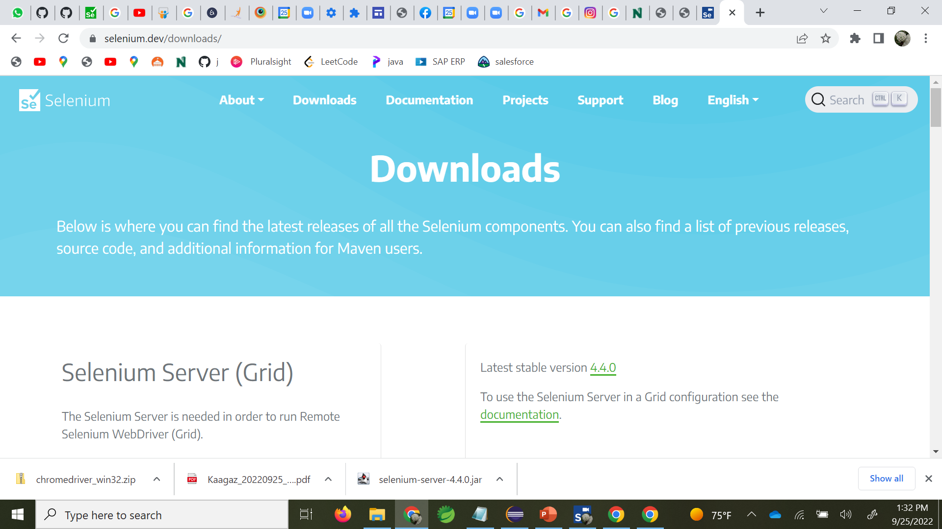
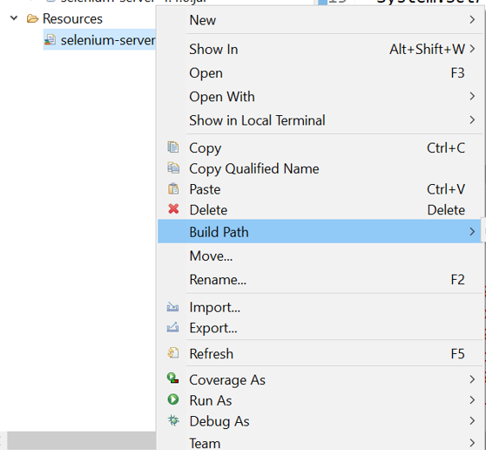
Visit: https://www.selenium.dev/downloads/
Adding jar file to eclipse
Fig: 4.2 Selenium WebDriver installation page
Fig: 4.3 importing jar file to IDE

Slide 20
Browser DRIVer
Selenium does not have built-in server to run automation code . So, we need a chrome/IE driver server to connect code with browser.
Link to download Chrome Driver : https://chromedriver.chromium.org/downloads
Steps :
1)Syntax to initialize driver : System.setProperty(" propertyName" , " Value")
2)Create the instance for browser Driver
WebDriver driver = new ChromeDriver();
3) Use the driver instance to perform required actions.

Slide 21
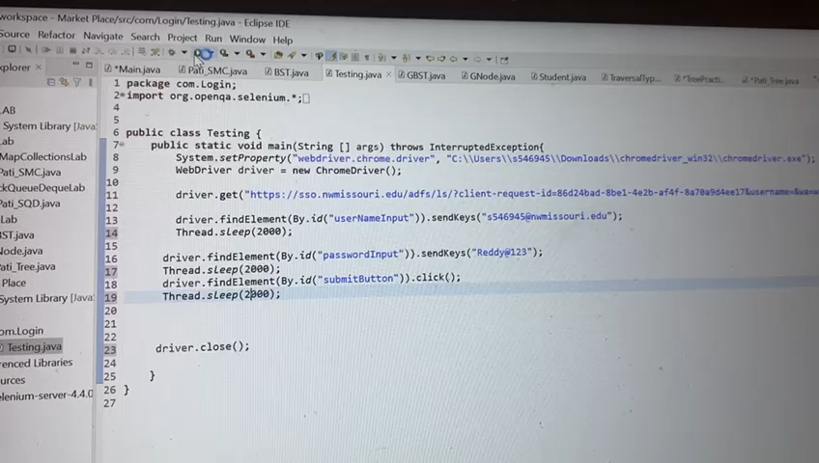
Functional testing using Selenese

Slide 22
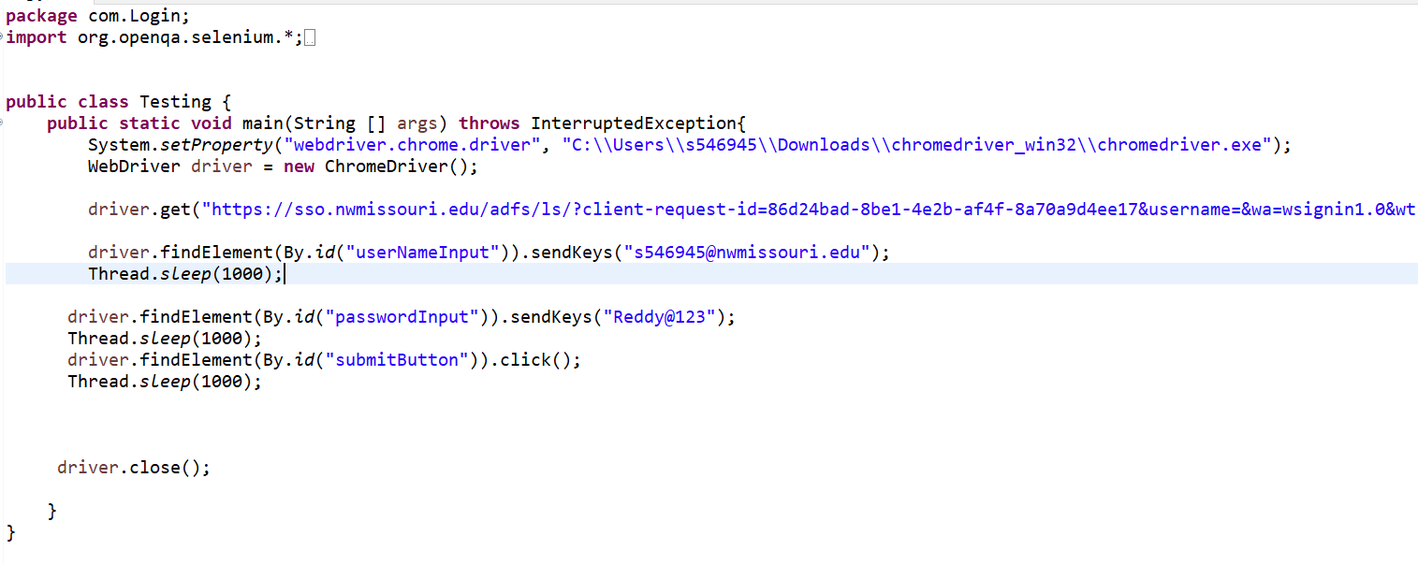
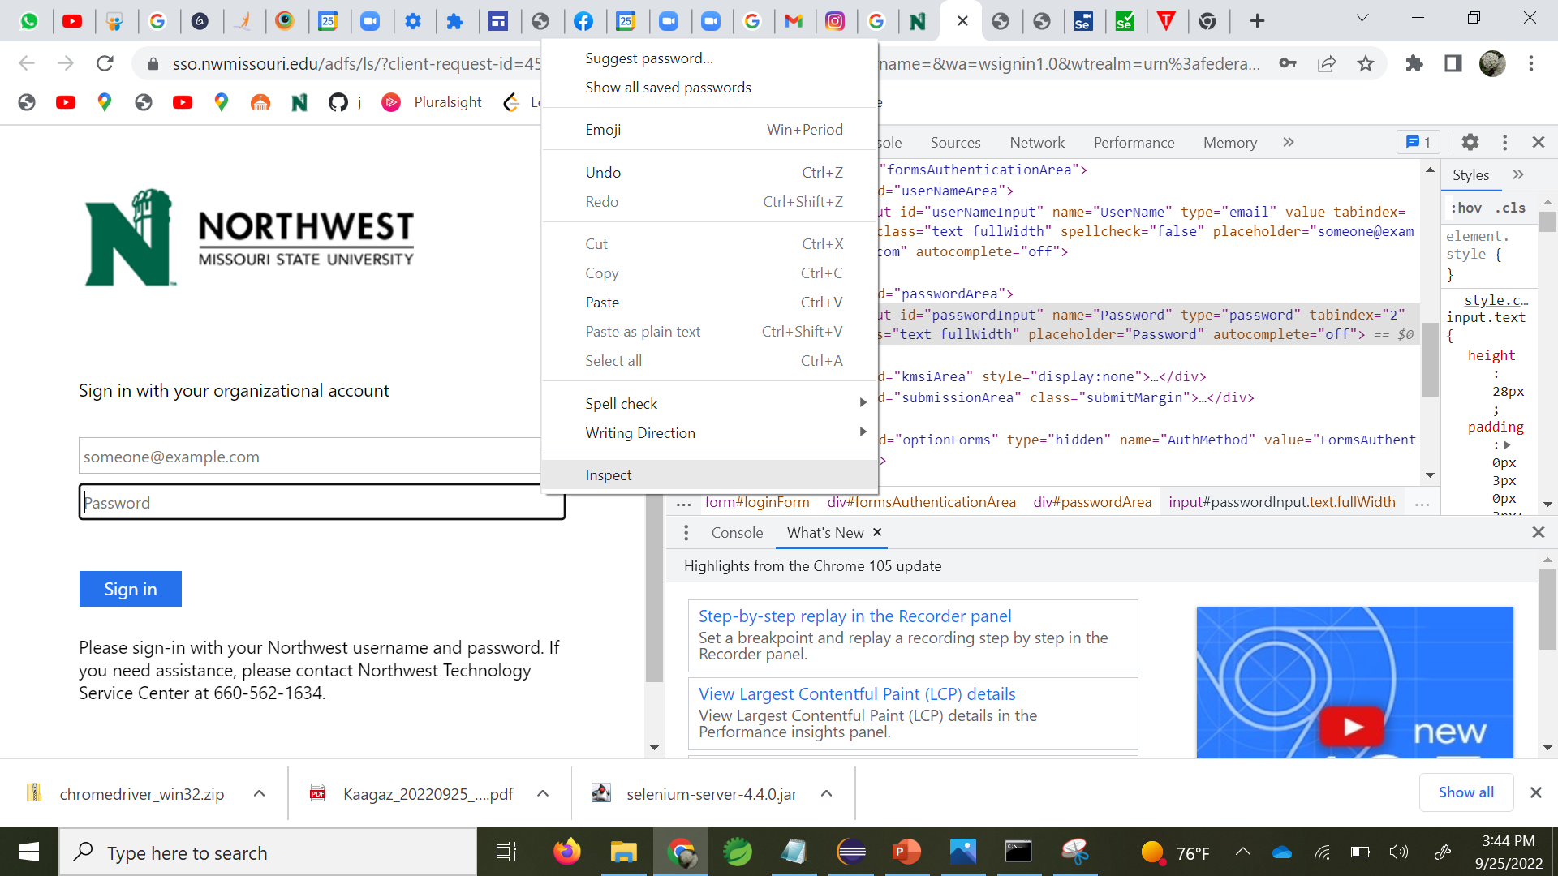
Fig: 4.4 Functional Testing Code
Fig: 4.5 Password text field inspection

Slide 23

THANK YOU

Slide 24
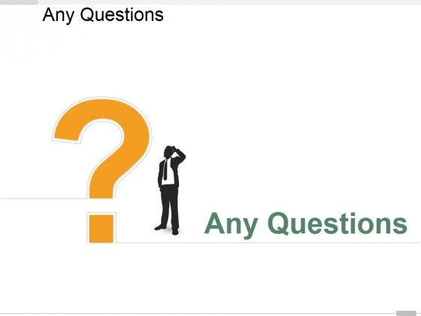

Slide 25
MARKETPLACE FOR NORTHWEST
Dr. Chandra mouli KOTTETI – Client/mentor
Hari Kiran aluri – Team lead/Front-end developer
Sajida mohammad – Backend developer
KIRAN KUMAR GUNDAPUNENI– Backend developer
USHA PATI – Tester/QA

